Slide 1
Thinking through Fintech Partnerships: Why You Should Prioritize Account Opening
September 12th, 2023

Slide 2
Simplifying account opening
40% of U.S. consumers stopped doing business with a company after experiencing poor customer service (Statista).
30% of CUs are expected to select a new consumer digital account opening app in 2023 (Cornerstone Advisors).
An estimated 5.7 million accounts will be opened digitally in 2024 (eMarketer).
Among banks that offer retail and small business deposit origination, abandonment rates exceed 50%, with more than 40% happening at qualification and nearly a quarter at funding (Cornerstone Advisors).
30% of people find funding an account via a payment app extremely valuable (Insider Intelligence).
90% of US execs find partnering with a fintech for account opening interesting or already utilized (Cornerstone Advisors).

Slide 3
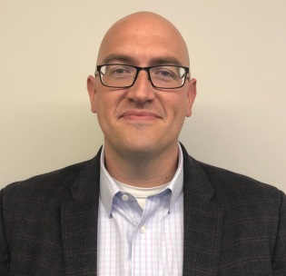
Meet the Panelist
Charlie McAdams
Director, Member Engagement Center
Y-12 Federal Credit Union

Slide 4
Navigating The Member Experience

Slide 5
Attracting new members
Video banking
Digital banking transformation
Terafina for digital account opening

Slide 6
Account Opening Initiative and Vendor Selection

Slide 7
Gaining buy-in
What’s
In
It
For
Me

Slide 8
Obstacles faced when selecting vendors

Slide 9
Terafina Platform vs. The Others
Roadmap
Salesforce platform
Reporting capabilities - “second to none”
Can see abandoned apps in real time

Slide 10
Advice for Other Credit Unions

Slide 11
Copy of roadmap
Vetting process in place
Multiple vendors
References

Slide 12
Metrics and Measuring Success
16%
quality applications received
Fraud trends
Will measure success through efficiency and manpower
Advertising still to come

Slide 13
Call/Contact Center Channels

Slide 14
Missing the Mark
Siloed channels
Omnichannel

Slide 15
5 Year Evolution
Not just live chat and phone anymore
Now look to knowledge-based bots
Texting + live chat
Video technology via ITMs and remote video banking
“Meet members where they are and how they want to be serviced”

Slide 16
Y-12 Gives Foundation

Slide 17
Questions?

