Slide 1


How Opportunities Can Blossom In Banking Deserts
United Bay Community Credit Union

Slide 2
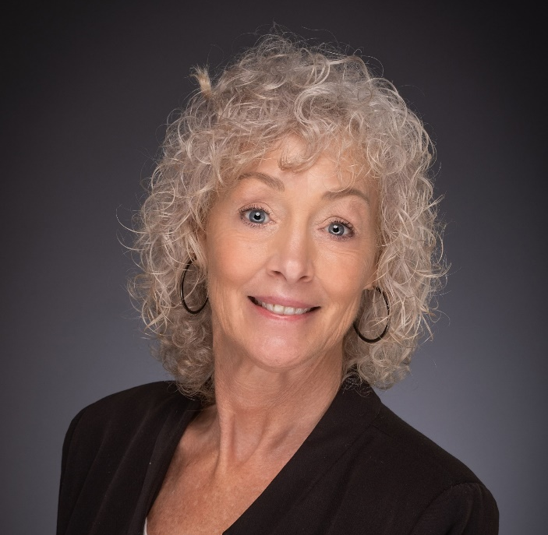
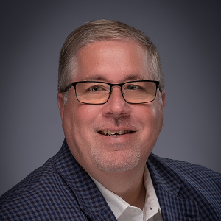
Our Speakers from United Bay
Who we are
Diane Abbonizio,
CEO
Doug Kelley,
CFO

Slide 3
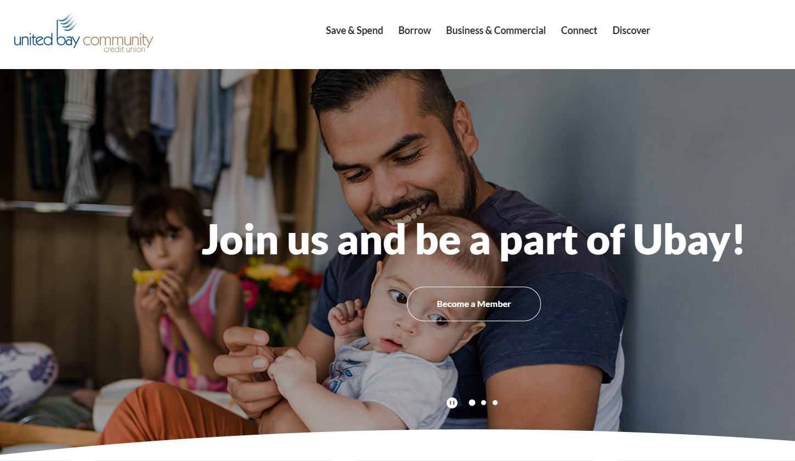
Who we are
About United Bay
Bay City, MI
Approx. $278M in assets
Over 18,000 members
73 FTEs
6 branches

Slide 4
Who we are
The Challenge/Opportunity
In Michigan, 321 bank branches closed between June 30, 2020, and June 30, 2022, according to FDIC data. Beyond closing branches, nine financial institutions left the state altogether during that same period.
Serving newly created banking deserts is an opportunity to live the cooperative mission while charting a new path to sustainable growth.
A vacancy Huntington Bank had left in Coleman, MI was causing a hardship in the community. Small business owners would have to close and drive 30 minutes to access the closest financial institution.

Slide 5
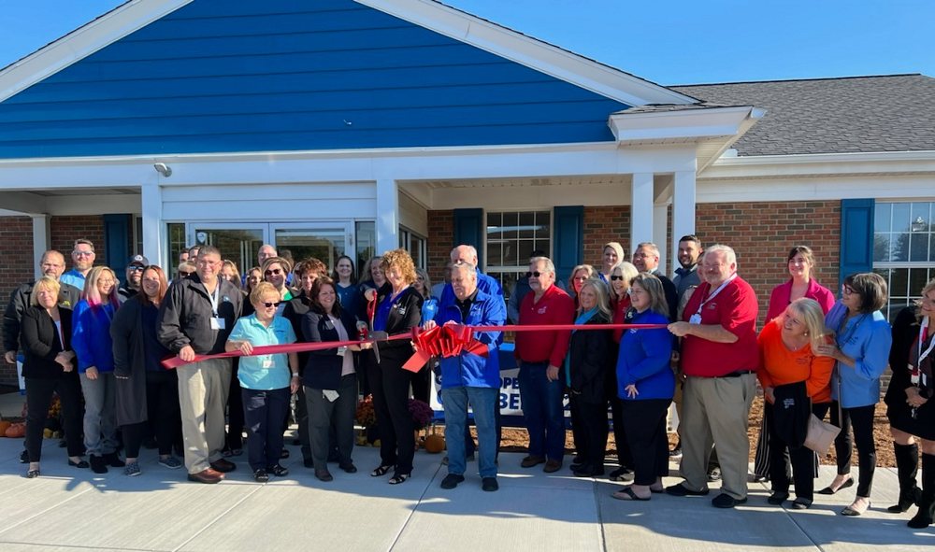
Who we are
United Bay Community Credit Union opened a branch in Coleman, MI, in October 2022, just in time for the high school’s homecoming week festivities. The credit union has opened more than 50 business accounts in the past year, and its presence has encouraged other development.

Slide 6
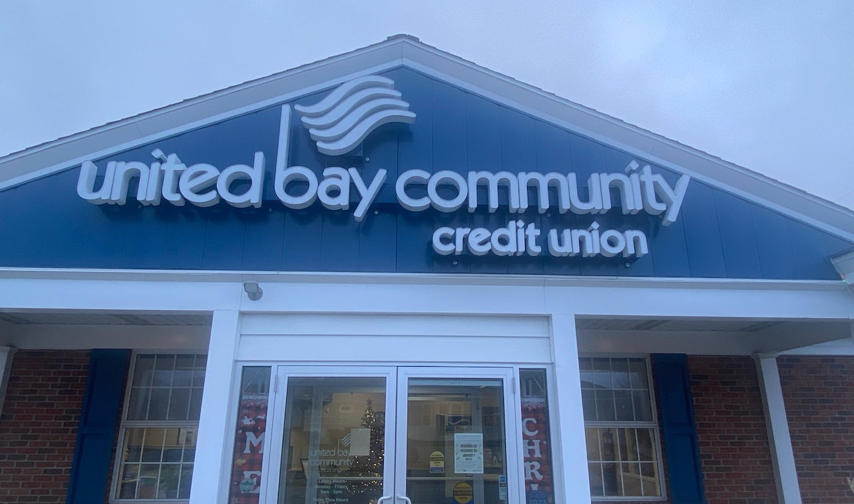
Who we are
The new branch – complete with new signage!

Slide 7
Uncovering Community Needs
We learned of the need from a village president in one of the neighboring communities where United Bay had been considering opening a branch in 2020.
Although that location wasn’t a fit, those conversations opened the door to serving Coleman and growing the credit union’s small business accounts.
During the past year, United Bay has opened more than 50 business accounts and continues to build new relationships each day.
Although the credit union provides financial convenience, its impact has been much greater.
Ownership in the credit union is giving people pride back in their town.
7

Slide 8
Building Trust When New to the Neighborhood
In March 2022, we announced the credit union’s move into Coleman at a local hair salon. A large contingent of members from the Coleman Business Alliance was present, which helped foster excitement and build trust from day one.
Next, we began to build our staff and found a branch manager who had grown up in Coleman and wanted to return home. Everyone working in Coleman is from there. We strive to have that hometown feel.
We also began volunteering in the community and attending local celebrations before the new branch opened. Our team partnered with veterans’ organizations, donated funds to the area’s park, and participated in Coleman’s Christmas parade.
Thanks to grant funding and our local connections, we recently replaced the scoreboards for the community’s high school.
8

Slide 9
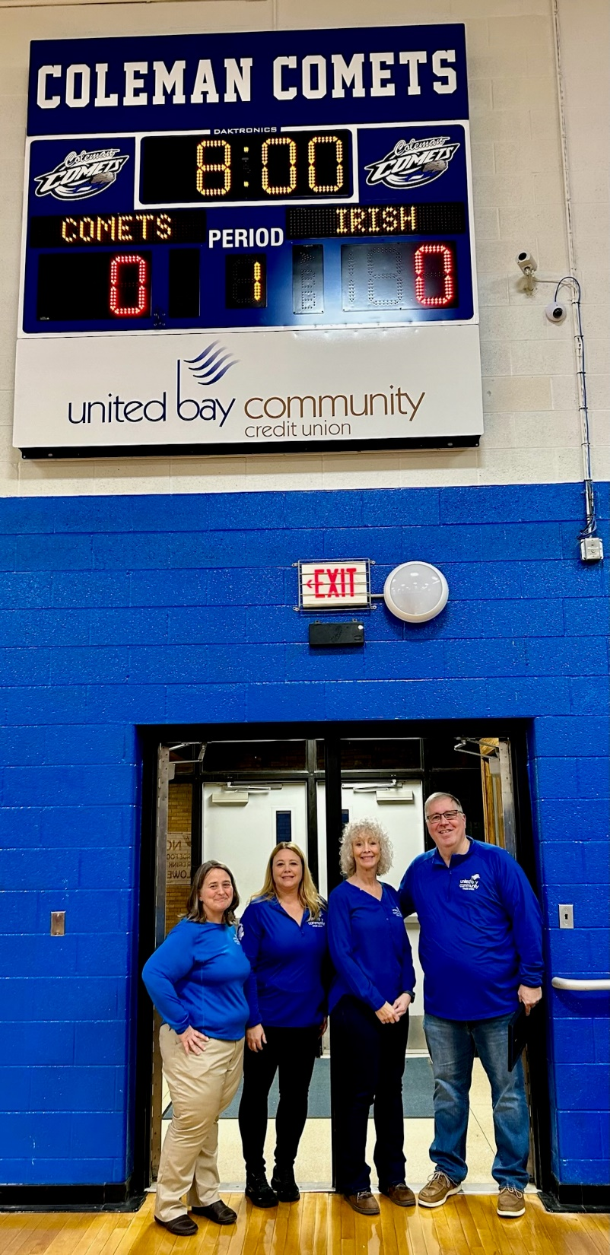
Who we are
One of the recently replaced scoreboards at the local high school in Coleman, MI.

Slide 10
Creating Excitement & Restoring Hometown Pride
We recognize the credit union can’t do everything, but its mere presence holds a lot of power. We’re creating energy and excitement here.
For example, after our new branch opened, someone bought a facility and turned it into a grocery store.
For some members, the memories of bank mergers and branch closures are still fresh, and it takes time to rebuild their trust.
We’ve had people wait six months and then come in and say ‘OK, now I can open an account.’
Longevity is important, and we had to show them we are committed to being here.
10

Slide 11
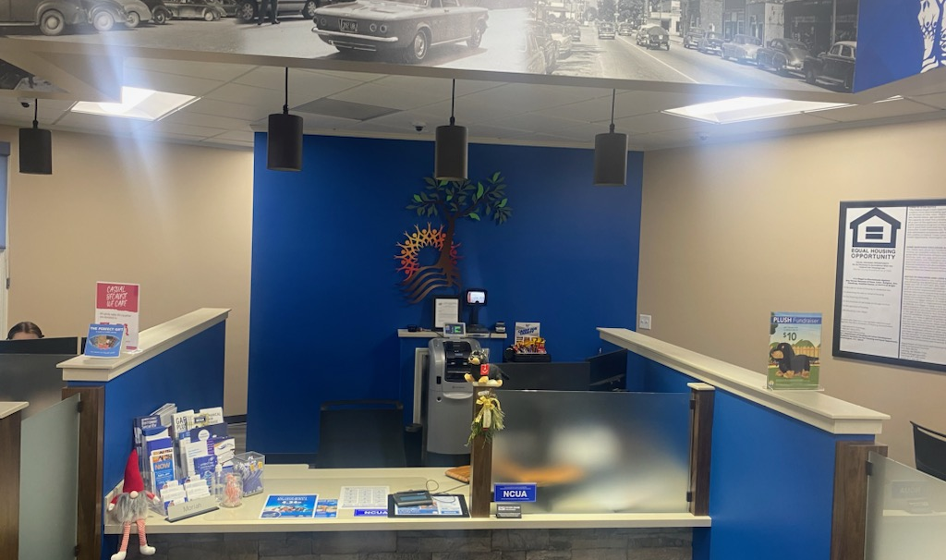
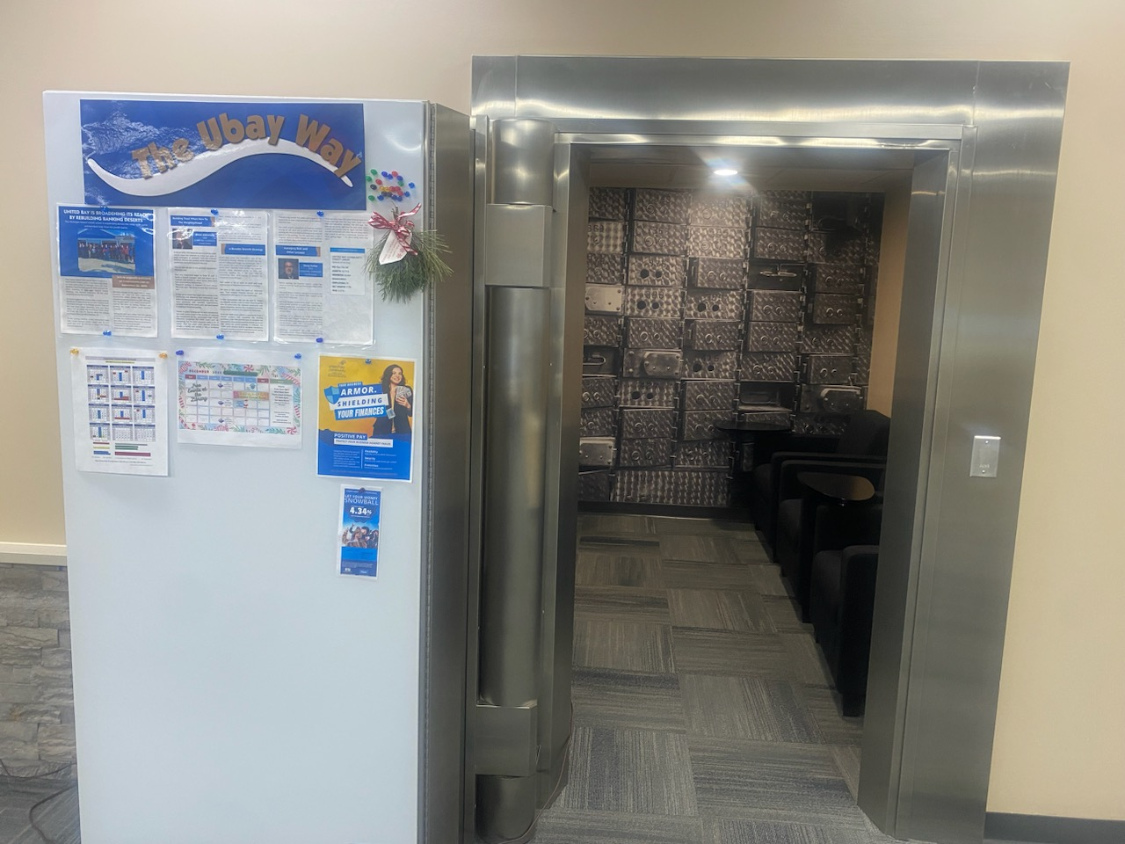
Who we are
Above the teller line, old pictures of Coleman are a key design feature of the new branch.
The old vault is now a community room.

Slide 12
Part of a Broader Growth Strategy
Our broader strategy is to connect Bay City and the Kalamazoo/Portage area of Michigan. With a full state field of membership, we’re looking to broaden our “handprint” across Michigan.
We typically spend a year or more researching the area to understand the business community and assess properties. Factors like a location’s proximity to downtown and drive-thru access are important.
Once we select a community, find a branch location, and complete the building purchase, it can take another year to complete the renovations required to brand the branch as United Bay before the grand opening.
In Coleman, we pushed hard to complete renovations in seven months to open the branch during the local high school’s homecoming week. There’s a big parade that week and it gave us the opportunity to make a big impression as we opened.
12

Slide 13
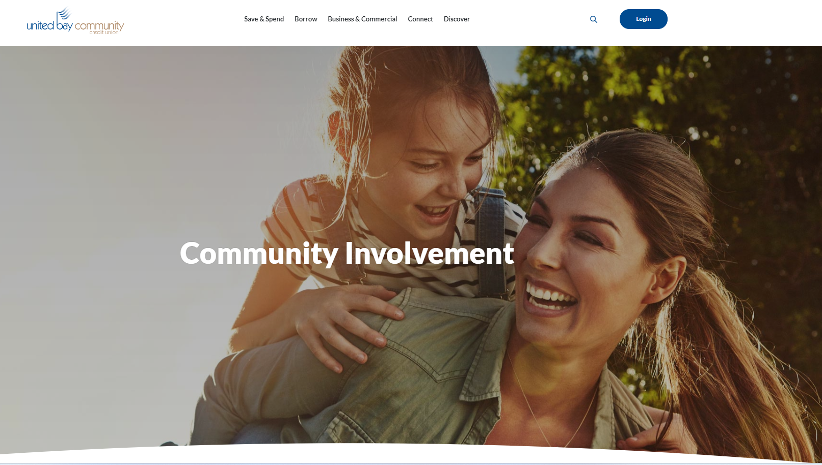
Connecting with the Community
Our renovations in Coleman included turning an old vault into a community room
We also worked with the local historical society to incorporate artwork in the building.
The old vault door is now a magnetic board where flyers about local events are posted, making us even more of a community hub.
13

Slide 14
Managing Risk & Other Lessons
Who we are
Before opening the Coleman branch, we spent time talking with local businesses and letting them know the credit union needed their support to be successful.
Michigan is a collection of small communities. People in Coleman are telling their friends 30 miles away about us, and we’re now having conversations with the surrounding farming communities about what they need.
We recommend all credit unions, but particularly smaller shops looking to expand, start by creating a statement of purpose and sticking to it.
There are well over 200 vacant financial institutions in the state right now that have been closed due to M&A and population declines. But they are not all the right ones for us.
Figure out your niche and feel comfortable with what you are doing before committing to serving a community. Success isn’t about getting bigger — it’s about being there long term.

Slide 15

Q&A Discussion Period

Slide 16
  THANK YOU FOR WATCHING
1001 Connecticut Ave NW
Ste. 1001
Washington, DC 20036
callahan@callahan.com
www.callahan.com
800-446-7453

