Slide 1


A Member-Focused Approach
To Internal Hackathons
Patelco Credit Union

Slide 2
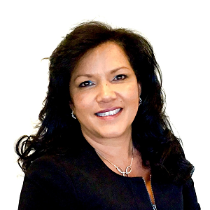
Our Speaker from Patelco Credit Union
Who we are
Stephanie Shah, Director of Portfolio Planning & Execution

Slide 3
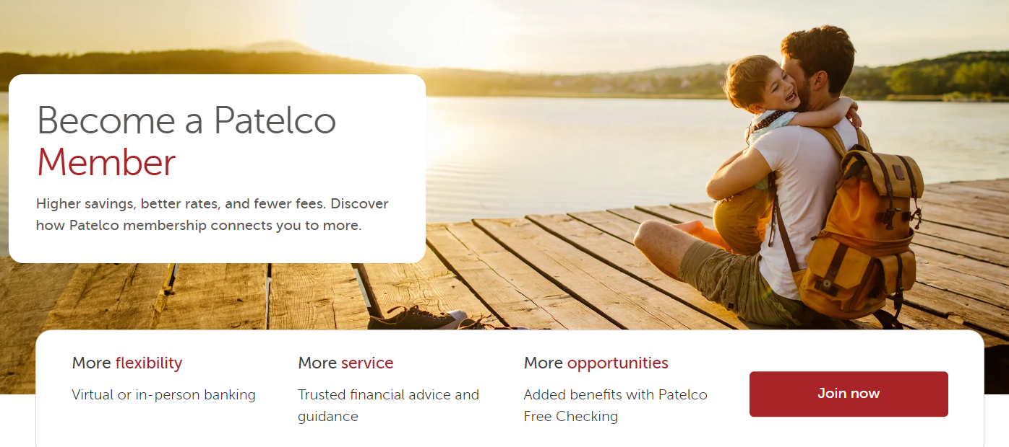
Who we are
About Patelco
Dublin, CA
$9B+ in assets
500,000+ members
850 FTEs
36 branches

Slide 4
Who we are
The Challenge/Opportunity
In our tech-savvy San Francisco market, we must continually adopt leading-edge technology.
As a consultant for Patelco, I was involved in multiple solution implementations including member-facing lending software, online banking, accounting solutions, and others before joining Patelco full-time nine years ago to lead Business Transformation.
Over time, our culture of innovation has moved from the waterfall to the agile philosophy of software and process development and deployment.
Instead of the traditional method of capturing all the requirements at once and then doing it all at once, we now have an agile way of taking small, incremental, collaborative steps to deliver business value.

Slide 5
Hackathons – A Natural Fit
Our solution was to bring together department experts and give them space to innovate so they can help solve procedural challenges.
Since 2019, we’ve held two or three “hackathons” every year. During these intense 48-hour events, employees pitch an idea, form a team, and rapidly pull together a working proof of concept.
Patelco benefits from ideas to improve efficiency while participants get to explore collaborative thinking and action.
Each hackathon gives teams a chance to work on things they want to learn and do. It’s an innovation engine that allows teams to self-organize and expand their thinking on how to solve problems.

Slide 6
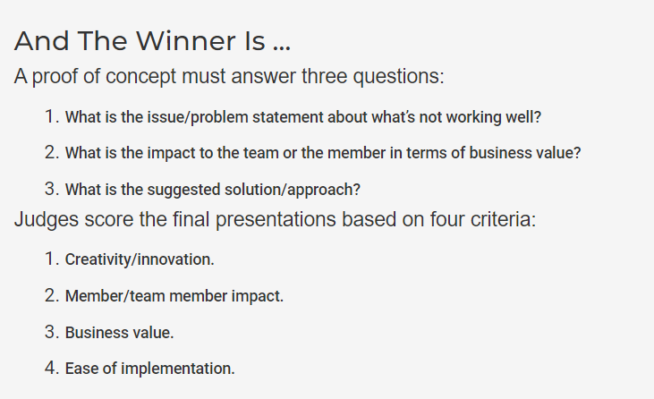

Slide 7
How “Hackathons” Work
We announce a “save-the-date” and encourage staff to submit problems they think can be solved quickly and efficiently.
Our system software architects vet those ideas to determine what’s realistic.
We get two or three times the number of ideas we can actually handle. Many are awesome ideas but too big to put together as a pitch and proof of concept (POC) in just 48 hours.
My team goes back to the staffers who presented the proposals deemed doable and invite them to team with technologists, product managers, data analysts, and anyone else who can contribute to a final pitch they’ll present at the looming hackathon.

Slide 8
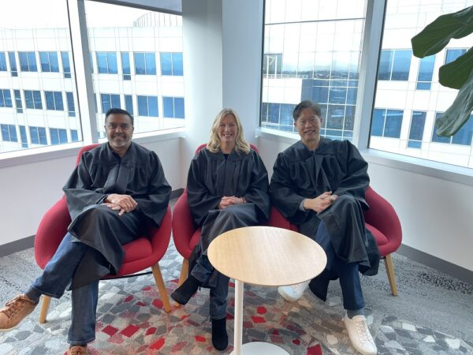
How “Hackathons” Work (continued)
Each hackathon can have a different focus, but teams always bring their own ideas to the table and self-organize according to their interests and talents to help deliver a solution. It’s all voluntary.
Team members can work in the space we give them or at home. They have 48 hours from start to finish.
The hackathon ends with 10-minute presentations to a panel of judges comprising senior executives. That panel then meets immediately afterward and render its decisions.

Slide 9
Who we are
Meaningful Work
The hackathon is one way we keep our member perspective and look at challenges with fresh eyes
To provide inspiration, we collect and share data on membership pain points from various sources, including:
  Complaints and problem-resolution system data
  Real-time listening posts for staff and members
  Gallup surveys
  Unanswered chatbot queries
  Member service platform data
That information becomes the palette of challenges that participants turn into opportunity

Slide 10
The Results
Several solutions are in various stages of development and a few have been implemented so far.
A resourceful team used machine-learning to better predict and spot fraudulent transactions. It was easy to test because we used a set of transactions we already knew were fraudulent to see if the solution would return the same result. That was key to the proof of concept in that case.
Another solution provides a way to pre-fill routing and transit numbers in online membership and banking forms, which saves members that manual task.
Another team created an appointment scheduler that allows members to set branch visits through our website.

Slide 11
Who we are
More than Money
Teams typically comprise three to six people, who split the modest monetary award — $1,000 for the winning team, $500 for the runner-up.
We don’t want to obscure the main point of what we’re doing here. The real incentive isn’t money or bragging rights, it’s solving a problem and being part of a creative, collaborative process.
The most crucial tip for hackathon happiness: allocate enough time to let creativity flow.
We remove two days from our technology team’s capacity that month to allow them the time to innovate. The pitch is on a Tuesday or Wednesday and the demonstration of working software is literally 48 hours later.

Slide 12
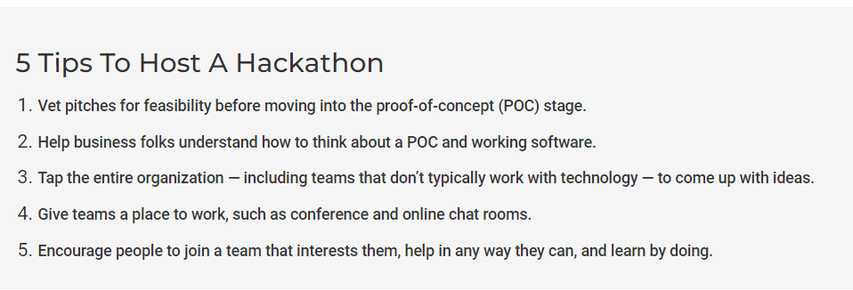
Keys to Success

Slide 13

Q&A Discussion Period

Slide 14
  THANK YOU FOR WATCHING
1001 Connecticut Ave NW
Ste. 1001
Washington, DC 20036
callahan@callahan.com
www.callahan.com
800-446-7453

