Slide 1


HOW TO NAVIGATE
NCAA PLAYER SPONSORSHIPS
Michigan State University Federal Credit Union

Slide 2
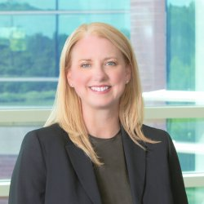
Our Speaker from MSUFCU
Who we are
Susi Elkins
Chief Community Impact Officer

Slide 3
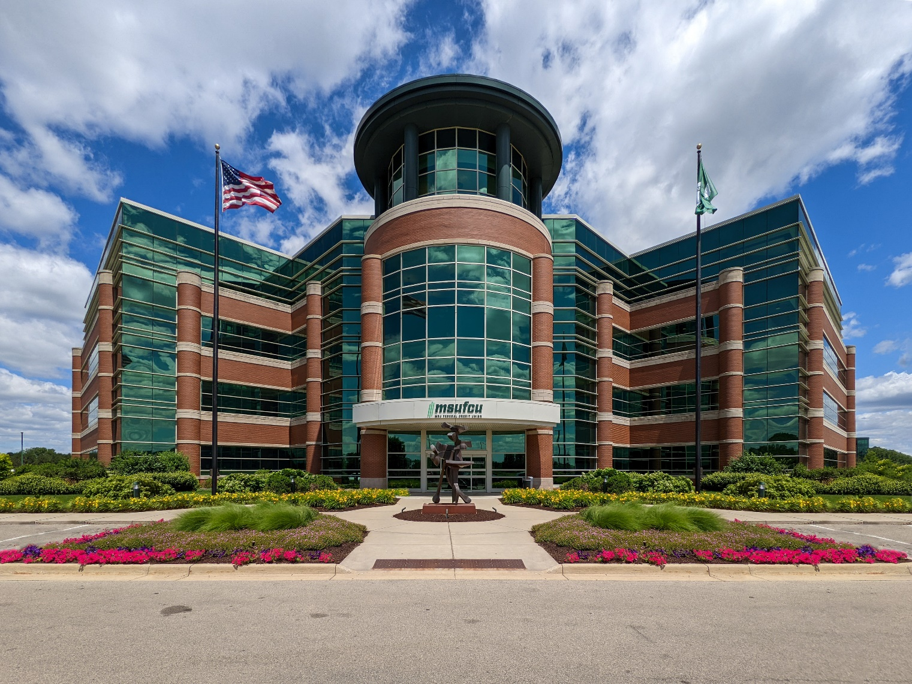
Who we are
About MSUFCU
East Lansing, MI
Over $7.45B in assets
Nearly 350,000 members
1,182 FTEs
23 branches

Slide 4
Who we are
The Challenge/Opportunity
In June 2021, the National College Athletics Association (NCAA) adopted an interim rule that allows players and their agents to enter into NIL deals with outside sponsors, opening the door for college athletes, like professional players, to earn money from endorsements.
So far, 31 states have adopted regulations to govern sponsorships of athletes enrolled within their state. In the remaining states, NIL deals are allowed by the NCAA as long as colleges establish guidelines.
Although a few NCAA players have signed multimillion-dollar NIL deals, most sponsorships are $500 to $1,500. Typically, these deals cost less because sponsors don’t have to license the university logo.
Notes:
Number of states who adopted regulations to govern sponsorships of athletes was updated based on 2023 tracking by a couple of legal firms.
https://www.troutman.com/state-nil-legislation-tracker.html
https://www.saul.com/nil-legislation-tracker

Slide 5
Who we are
The credit union has been a sponsor of MSU athletics for more than 13 years and became the presenting partner of MSU women’s basketball in 2019 as part of a multiyear athletics sponsorship agreement.
NIL contracts were the natural next steps.
The credit union sponsored all eligible players on its namesake Michigan State University women’s basketball team for the 2022-2023 season and track athlete Nala Barlow for the 2023 season.
MSUFCU’s Approach
“MSUFCU and their leaders are pioneers in recognizing women’s athletics,” says Moira Joiner, one of 16 MSU athletes with NIL sponsorships. “We are glad to be a part of their vision for our collective future.”

Slide 6
Who we are
How It Works
Each athlete receives $700 per month in compensation for in-person appearances at events, marketing, promotions, and social media posts.
MSUFCU may also feature student-athletes in print ads, billboards, videos, television commercials, and on other platforms.
Our contracts with all 16 women student-athletes are similar in value to one TV/radio campaign. But the value with this campaign is that it will run for several months and is more targeted to our target audiences.
Notes:
2022-2023 – 16 athletes
2021-2022 – 12 athletes

Slide 7
To kick-off the second year of MSUFCU’s NIL partnership with members of the MSU Women’s Basketball Team, a celebration event was held at MSUFCU’s Headquarters for the basketball players, fans, credit union members, and high school girls’ basketball teams from the region.
The event connected the athletes back to the Credit Union and community who support them and allowed MSUFCU to shine a light on the student athletes' accomplishments through this partnership.
NIL Announcement Celebration

Slide 8
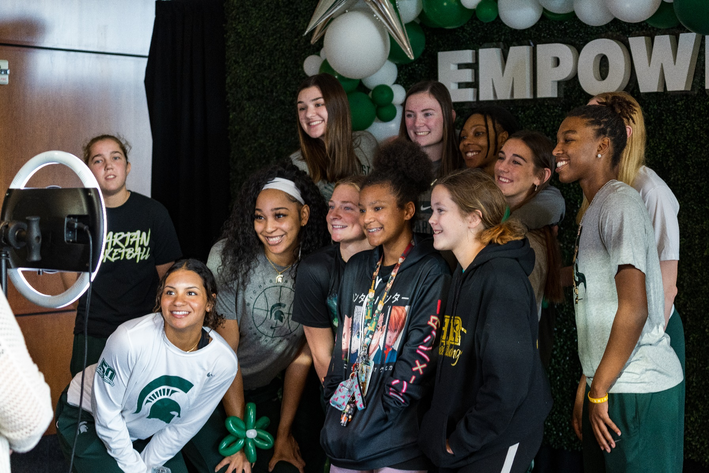
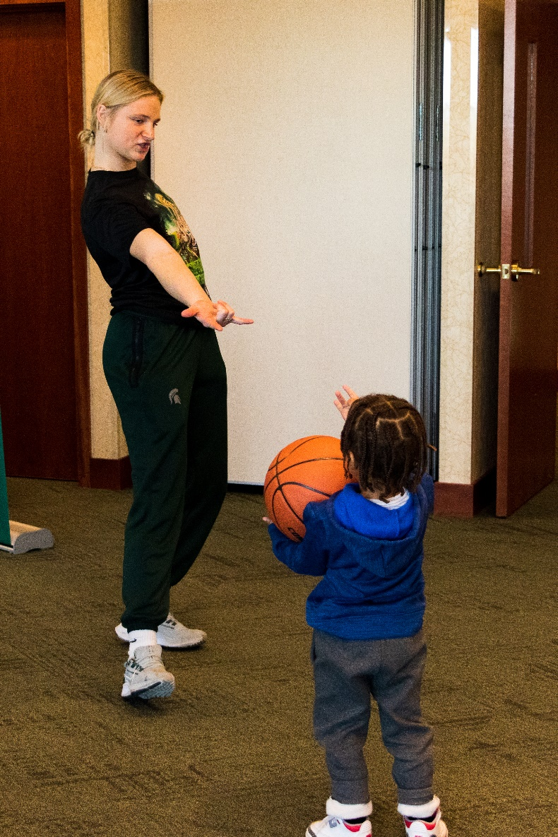

Slide 9
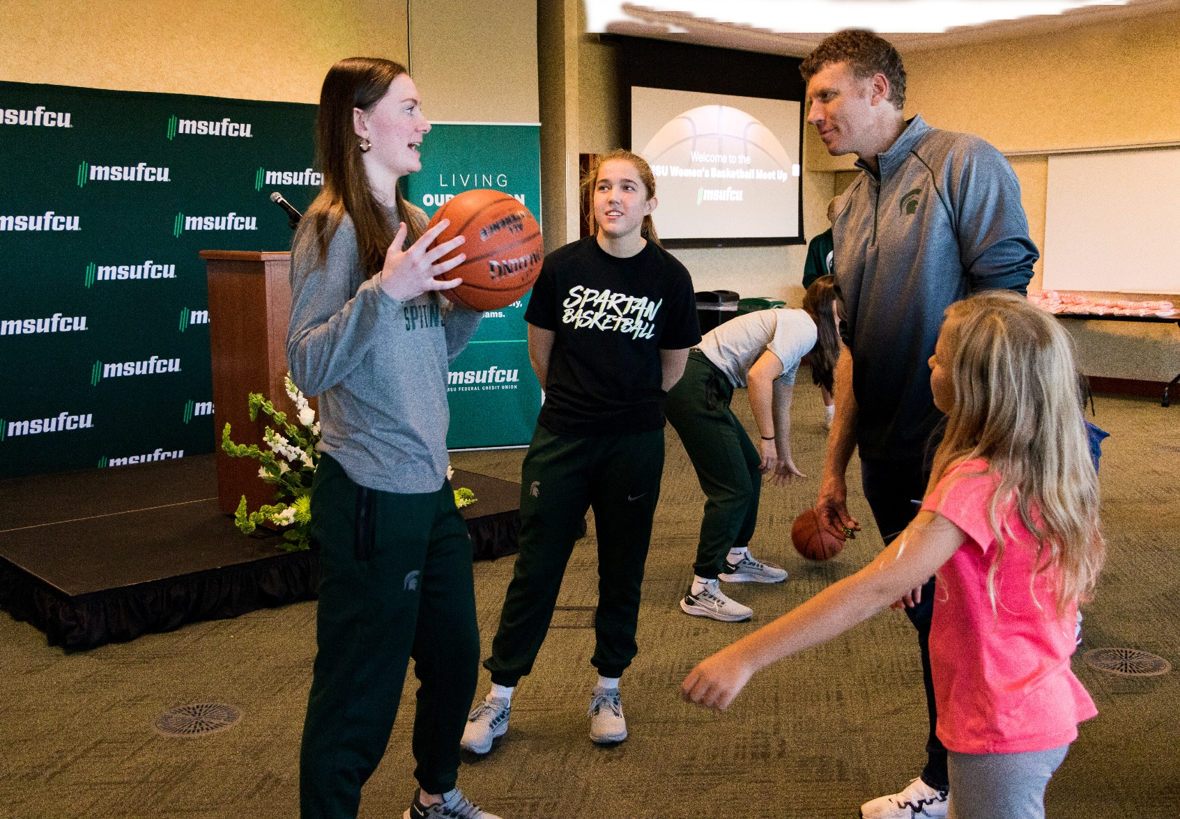
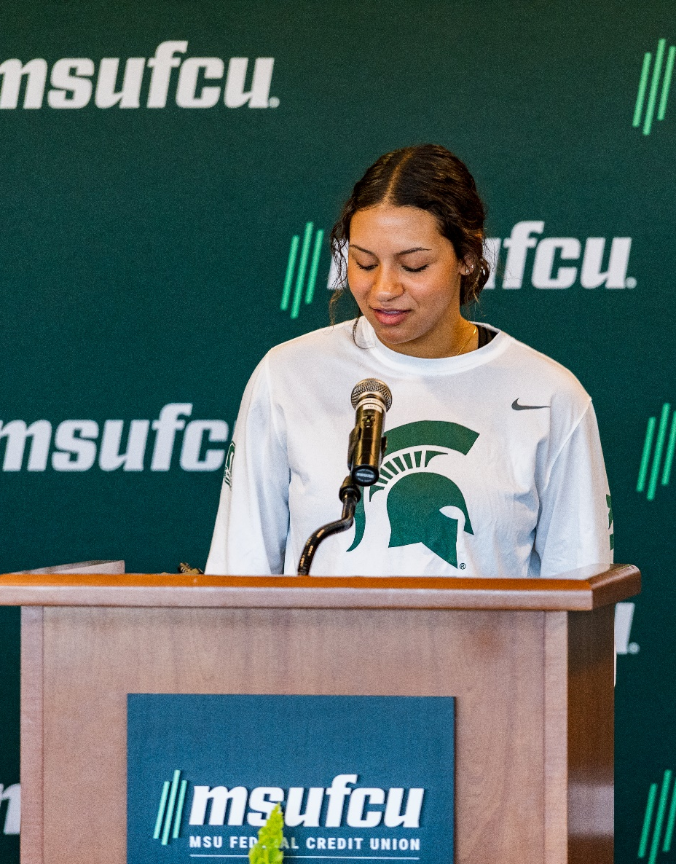

Slide 10
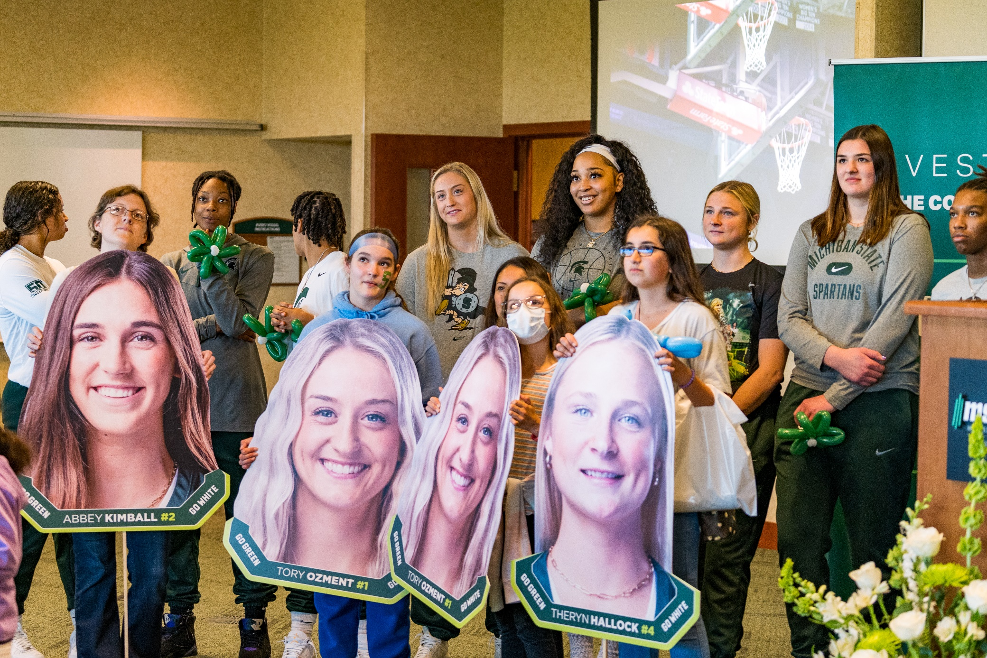

Slide 11
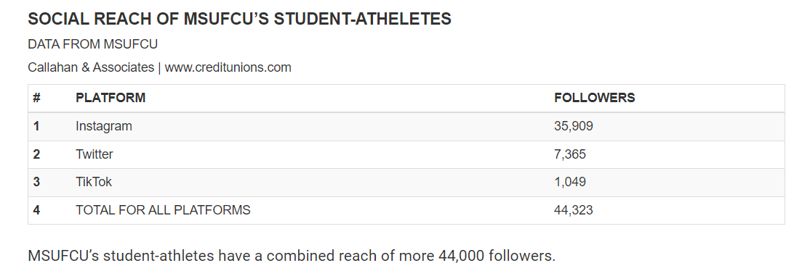
Social Media Stats from 2021-2022
11
Notes:
Instagram – 40,306
Twitter – 12,695
Tiktok – 4,909
Total – 57,910
MSUFCU’s student athletes have a combined reach of nearly 58,000 followers

Slide 12
Expanding Influence
With 10 of the 12 MSU women’s basketball team members and track star Nala Barlow posting regularly on social media, their combined influence reaches more than 44,000 followers.
Although MSUFCU doesn’t have analytics from the players’ accounts, it’s definitely seeing an uptick in traffic from player posts. We’ve noticed a lot of notifications on our social feeds from the players. It’s obvious we are receiving more interaction on our social profiles as a result of the athletes’ posts.
Engagement with posts on MSUFCU’s social media channels is also strong. From 9/1/22 to 7/19/23, a total of 34 posts featured NIL Athletes on MSUFCU’s social media. These posts generated 52,114 Impressions, 3,032 engagements and an Engagement Rate of 5.8% across Facebook, Twitter, LinkedIn and Instagram.

Slide 13
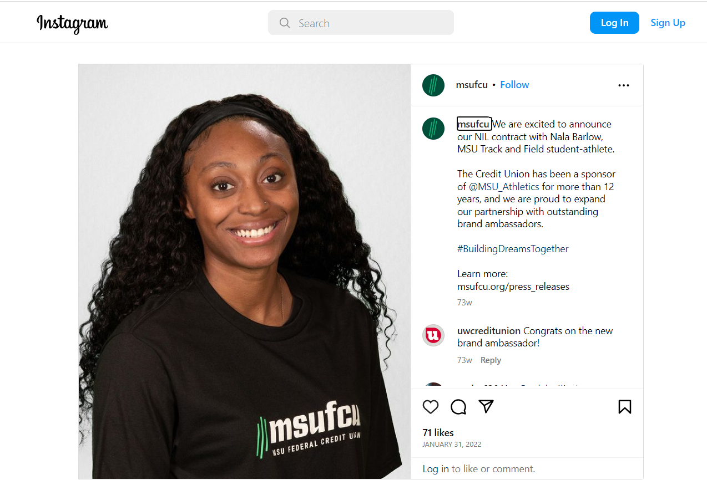
13
Notes:
Example of MSUFCU NIL partnership and athlete post

Slide 14
Increasing Engagement
The credit union also sponsored several women’s basketball ticket giveaways for members on Facebook and Instagram throughout the season.
Each post generated 1,846 impressions on average.
Each post generated 52 Engagements on average
MSUFCU is tagged much more often on Instagram with the NIL athletes posting on our behalf, which is helpful for our algorithm and overall audience reach.

Slide 15
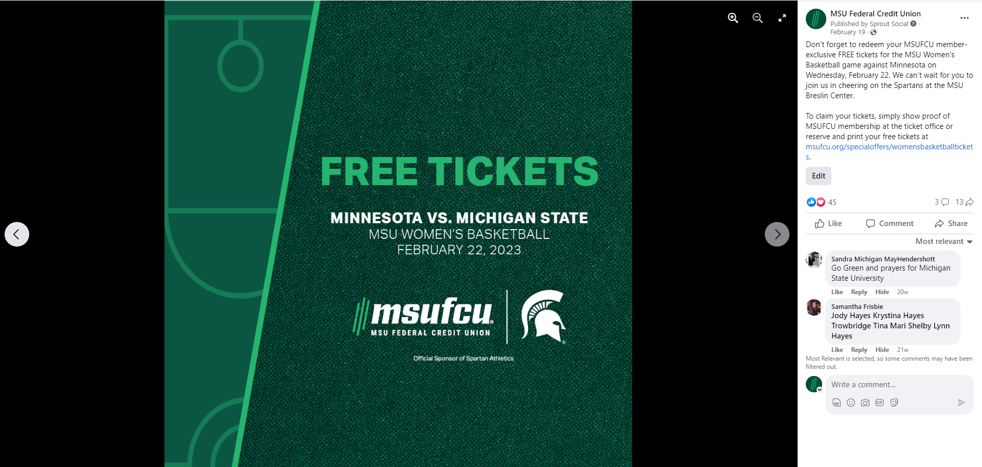
15
Notes:
Example of ticket giveaway post.

Slide 16
Who we are
Keys to Success & Lessons Learned
A big part of sports marketing is reacting quickly to unexpected opportunities.
Two of MSUFCU’s most successful social posts over the season highlight unique NIL opportunities. A spotlight of the Evergreen NIL Financial Education Event sponsored by MSUFCU generated 7,220 impressions across all platforms and 695 engagements, and images from an event featuring NIL Athletes meeting students in our Lansing SAVE Program, generated 5,609 impressions and 622 engagements
The NIL landscape is a brand-new frontier that is ever-changing, but it does demonstrate that the value of influencer marketing is alive and well.
We are continuously learning as new student-athlete partnerships are launched. And as these programs evolve, we hope to continue to collaborate with athletes in meaningful and innovative ways.

Slide 17
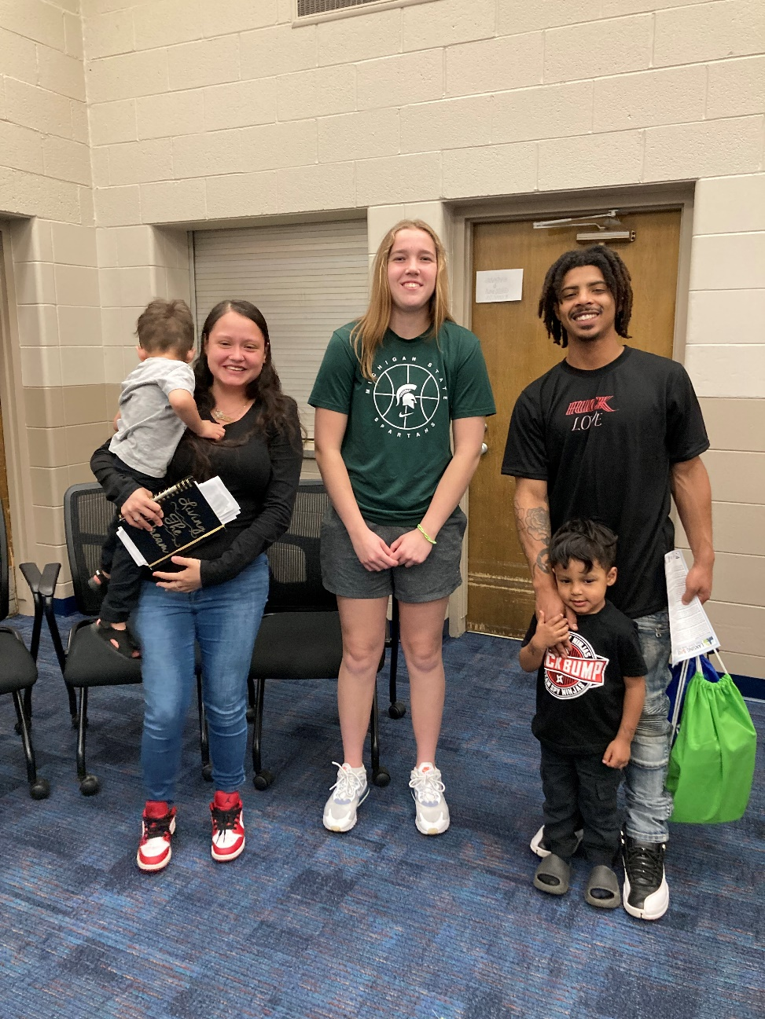
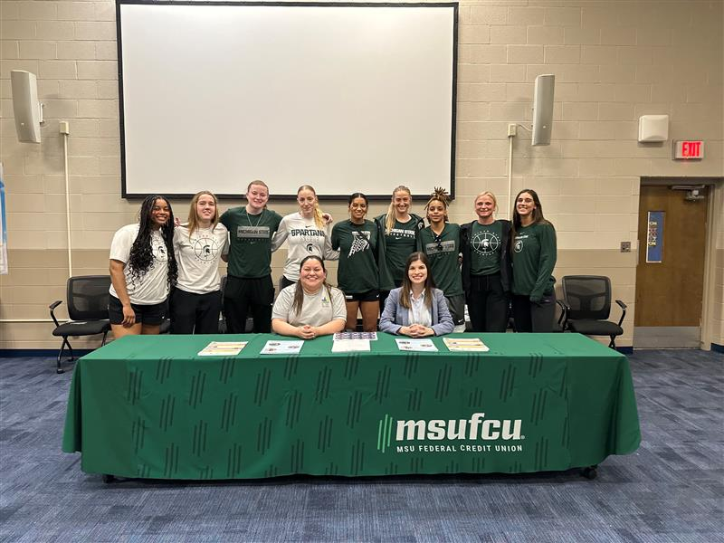
Notes:
NIL Athletes attend Lansing SAVE event.

Slide 18
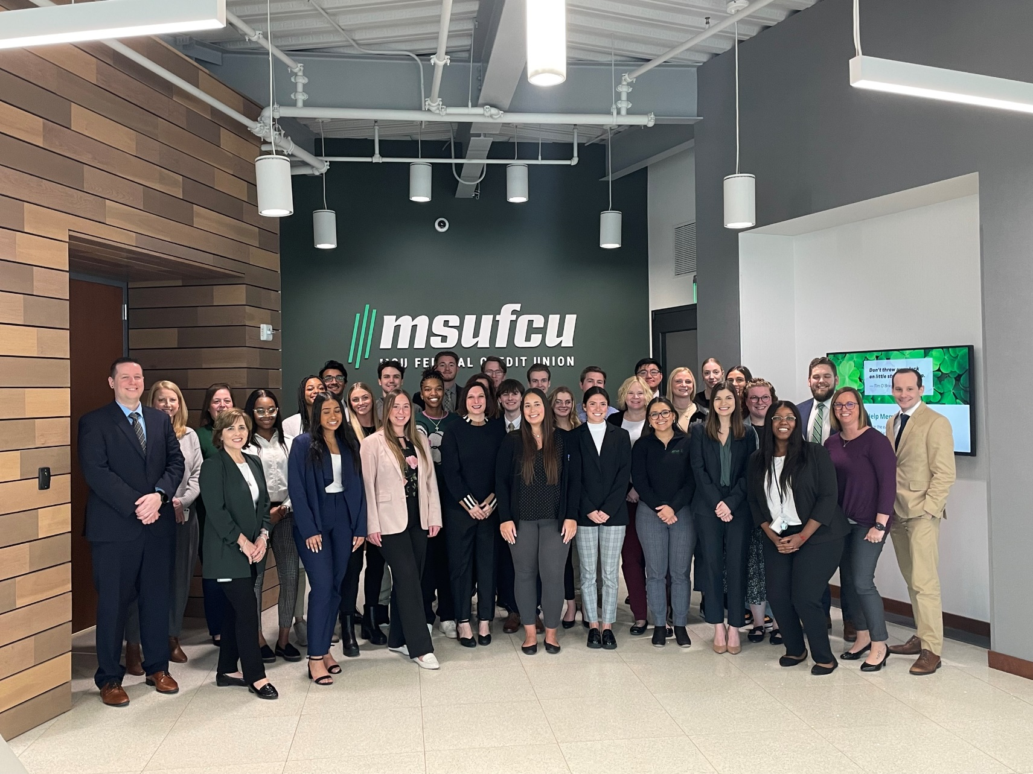
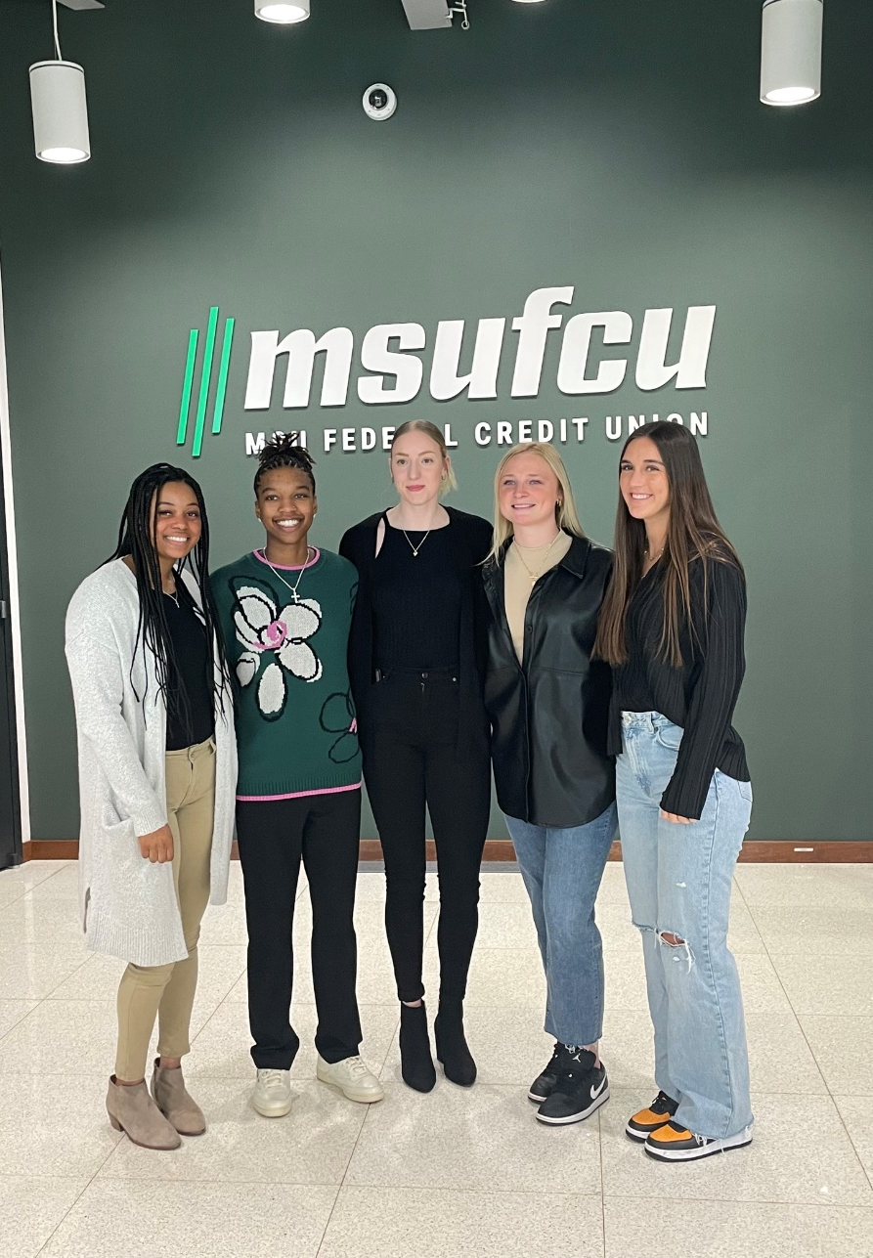
Notes:
MSU NIL Athletes attend MSUFCU Intern Summit

Slide 19

Q&A Discussion Period

Slide 20
  THANK YOU FOR WATCHING
1001 Connecticut Ave NW
Ste. 1001
Washington, DC 20036
callahan@callahan.com
www.callahan.com
800-446-7453

