Slide 1

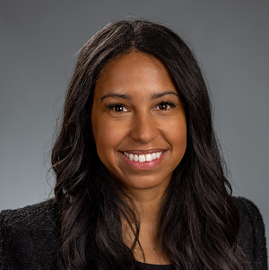
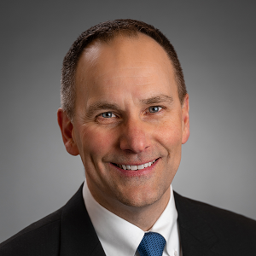
SUSTAINABLE GROWTH THROUGH
INCLUSION, DIVERSITY, EQUITY & ACCESSIBILITY
Rachel Melendez Mabee, VP of Diversity, Equity, Inclusion, and Accessibility, Greylock FCU
John Bissell, President & CEO, Greylock FCU

Slide 2
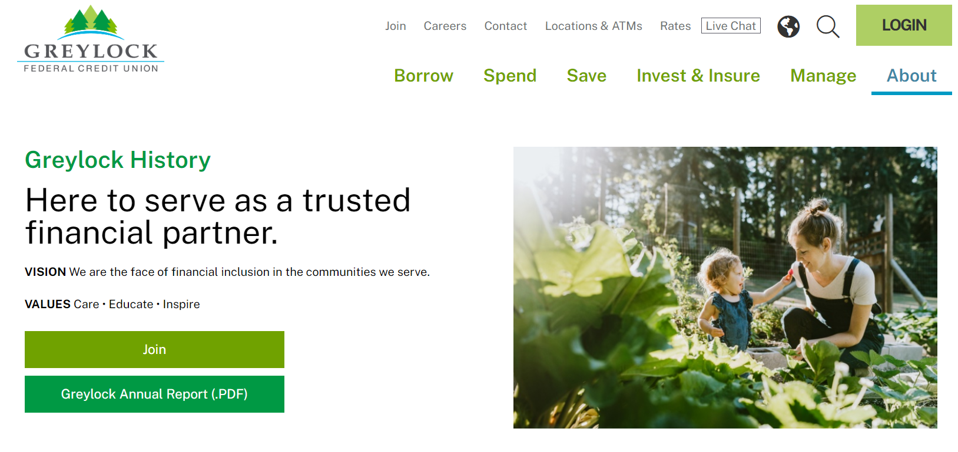
Who we are
About Greylock FCU
Pittsfield, MA
$1.6B in assets
Over 100,000 members
322 FTEs
14 branches

Slide 3
Who we are
The Challenge/Opportunity
Our market covers sparsely populated rural areas in western Massachusetts, eastern New York, and southern Vermont
The general population has been shrinking for decades. However, we saw a clear trend and area of opportunity.
Our immigrant community and people of color were the only demographics that were growing.
Prior to 2015, we’d been trying, and failing, to do a better job serving more diverse communities.
We had to change our culture to remain relevant.

Slide 4
Who we are
The Big IDEA (Inclusion, Diversity, Equity & Accessibility)
Working with outside consultants, we began by educating the senior management team and board. As CEO, I underwent a deep self-examination to uncover my own biases.
A partnership with the local non-profit Multi-Cultural Bridge and connections established through Inclusiv helped us build a roadmap for IDEA.
That high-level work lasted a couple of years. Then, we turned our attention to the broader organization, providing cultural competency training and a shared vocabulary to all staff members.
The business case was made to all employees, with a clear message. We shouldn’t take our long-term growth or this community for granted. Our community is changing, and we have to continue listening and responding to their needs.
Next, the credit union began changing systems. A long-term process that will continue.

Slide 5
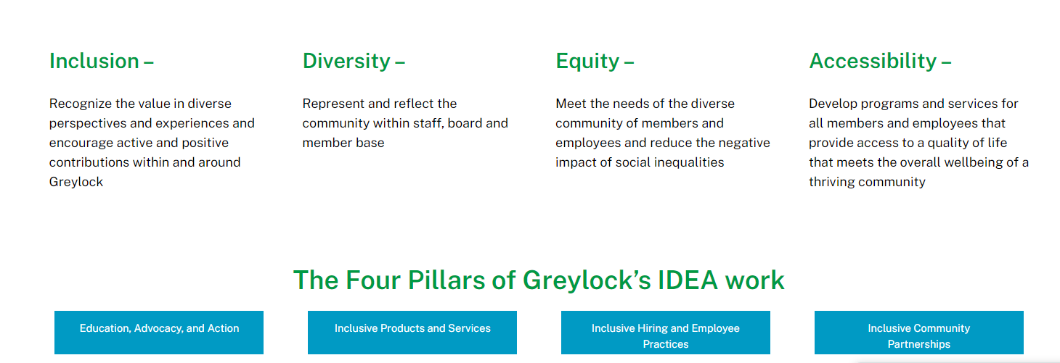
IDEA Commitment
“Greylock is committed to accelerating our culture of equity and inclusion where every individual belongs. The outcome is to foster a culture of belonging aligned around an inclusion strategy that reflects local nuances and regional priorities. It is also critical to embed Inclusion, Diversity, Equity and Accessibility (IDEA) into our business strategies to better serve the needs of our all of our members, volunteers, stakeholders and customers. The diversity of our membership also makes our credit union stronger.”

Slide 6
Changing from the Inside Out
Greylock became a Community Development Financial Institution (CDFI) and received a low-income designation.
We also completely re-engineered how the credit union recruits, hires, and trains to better reflect the community.
Today, no one can hire or promote someone unilaterally, which has helped increase diversity among our employee base. In 2015, people of color represented only 3% of staff; today, they represent 15%.
We changed a lot of other systems and we’re not done. This will be the rest of our lifetimes and more…
We recently added a vice president of diversity, equity, inclusion, and accessibility position to help us continue forming true community partnerships and our commitment to being “comfortably uncomfortable.”

Slide 7
Putting the “A” in “IDEA”
We look beyond the typical race, ethnicity, and gender aspects of diversity. Access is also a critical component of our strategy.
Our local population has a higher-than-average percentage of people living with physical and mental disabilities, people who are facing language barriers, and — our largest segment of the underserved population — 60-65% of the community who have low-to-moderate incomes.
As we connected with other CDFIs and LICUs (low-income credit unions) throughout the country, we recognized our products and services were too limited.

Slide 8
Coaches & Products for Community Needs
We’ve built a team of 30 certified financial coaches who can serve members in multiple languages..
We also designed an affordable auto loan for credit challenged members with FICO scores lower than 660.
The loan offers a more competitive rate from the start. We also lower the interest rate for borrowers who make regular payments, which, in turn, increases their credit scores. By the time they pay off this auto loan, they qualify for conventional financing
On average, members save $900 per year, and Greylock booked a total of $5 million in 2022.

Slide 9
Who we are
Meeting More Needs & Listening to Feedback
For members who don’t have a social security number, we offer an Individual Taxpayer Identification Number (ITIN) lending program.
We made $8 million in ITIN loans in 2022 and will begin offering mortgages to those with ITINs in 2023.
As we continue to assess needs and evolve our business, the data helps us uncover where the biggest inequities are.
We’ve also formed Community Development Advisory Committees so stakeholders can provide feedback.
We visit with these groups monthly and bring them together once a quarter to ask where the gaps are and what we don’t have that we should have. We invite them to tell us what we need to know, even when it hurts.

Slide 10
Who we are
Success & Evolution
Prior to our IDEA strategy, we were growing by an average rate of 1,000 members per year. Now, our growth rate is an average of 3,300 new members per year.
Net income has doubled, and our asset quality has improved dramatically.
Our New ITIN lending program went from zero to $8 million and appears to have plenty of room to continue growing.
And, as the area’s top mortgage lender, we have a special responsibility to ensure equitable housing opportunities.
In 2015 there was a big gap, but now we’re exceeding the number of mortgage applications and mortgage loans funded to people of color that we would expect to see based on the population.

Slide 11
Who we areF
Lessons Learned & Advice for Others
We were hesitant at first to publicize the credit union’s IDEA work externally, but thoughtfully, genuinely engaging with community partners to drive systemic change has led to progress that we are now proudly sharing.
Having the full support of the board and management helps us navigate even challenging conversations with the few members who raise questions or objections.
Those awareness conversations are an important way to prevent members and employees from falling victim to a zero-sum mentality.
We’re not trying to achieve perfection and this isn’t going to happen overnight, so don’t get discouraged or deprioritize DEI if you don’t see immediate results.
A credit union is either on a DEI journey or they are on a pathway to extinction.

Slide 12

Q&A Discussion Period

Slide 13
  THANK YOU FOR WATCHING
1001 Connecticut Ave NW
Ste. 1001
Washington, DC 20036
callahan@callahan.com
www.callahan.com
800-446-7453

