Slide 1

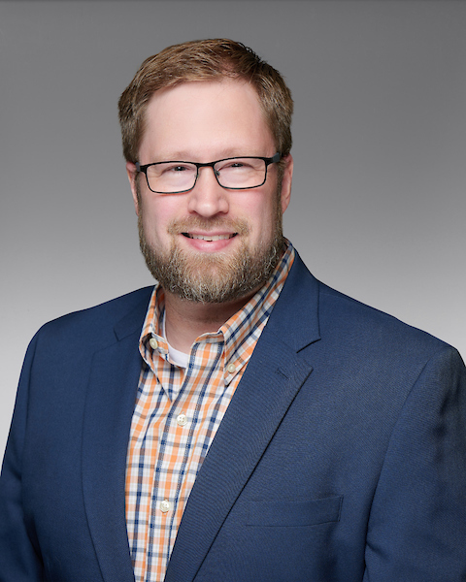
HOW TO PLAN FOR A SMOOTH CORE CONVERSION
A Panel Discussion
Hosted by Aaron Passman

Slide 2
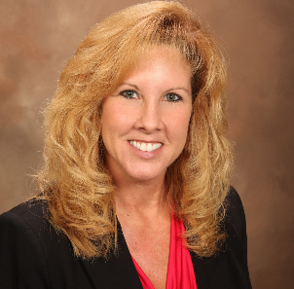
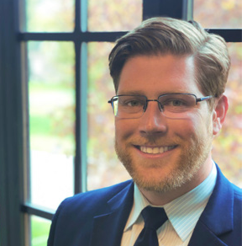
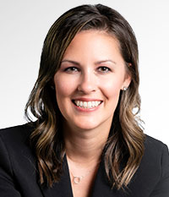
Panelists
Jenee Rawlings
President & CEO
Yolo Federal Credit Union
Jeff Kusler
CEO
Journey Federal Credit Union
Krista Jantzer
SVP of Marketing & Facilities
Rogue Credit Union

Slide 3
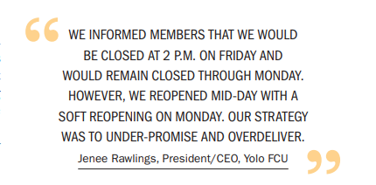
Yolo FCU
About the Credit Union
Conversion Quick Facts
Go Live: July 2023
Converted From: UltraData
Converted To: to Corelation’s KeyStone platform (as well as digital and mobile banking to Alkami)
Headquartered in Woodland, CA
Approximately $409M in assets
Over 22,000 members
5 branches, 70 FTEs
Notes:
We launched Affinity Gives Back Day on Columbus Day in 2017 and have since extended it to Affinity Gives Back Week to foster goodwill among employees, members, and community.
Employees volunteer with our Foundation’s charity partners, provide financial literacy seminars to nonprofits and local schools, and participate with causes they’re passionate about.
In 2019, 100 employees volunteered at 16 charities. In 2020, we had several individual/small team in-person opportunities (adapted to ensure safety/follow all COVID-19 guidelines) and volunteer from home options including mask making for Jersey Cares.
We know that volunteers are essential to tackling the crisis created by the pandemic to help communities heal physically and economically. We are in the process of surveying our employees to gauge their comfort levels and are scheduling events in areas where employees have expressed interest in volunteering this year.
Some of our partners over the years include America’s Grow-a-Row, Cornerstone Family Programs, the Flemington Area Food Pantry, Homeless Solutions and Lunch Break.
Throughout the year, we encourage our employees to submit their time to earn Volunteer Time Off, wear Affinity branded clothing to their events, set their out of office messaging, share their photos and spread the word on social that they’re giving back with #AffinityCares
This year, we plan to incorporate more virtual opportunities in our program and will keep working with community partners to offer help where it’s needed most year-round.
During our week of service this year, we will celebrate our Foundation and community impact, host our annual volunteer appreciation lunch, and offer financial wellness free for the community.

Slide 4
Journey FCU
About the Credit Union
Conversion Quick Facts
Go Live: December 1, 2022
Converted From: Fiserv’s CUnify
Converted To: to CU*Answers platform for core processing, mobile app and online banking
Headquartered in St. Johns, MI
Approximately $179M in assets
Over 17,700 members
3 branches, 42 FTEs
“
WE HAD HEARD HORROR STORIES ABOUT THE ACTUAL CONVERSION PROCESS TAKING WEEKS IF NOT MONTHS AND RESULTING IN SIGNIFICANT LEVELS OF TURNOVER. OUR CONVERSION, FROM THE TIME WE BROUGHT DOWN OUR OLD PLATFORM AND STARTED ON OUR NEW SYSTEM WAS ABOUT TWO-AND-A-HALF DAYS, AND WE EXPERIENCED ZERO TURNOVER.
Jeff Kusler, CEO, Journey FCU
”
Notes:
We launched Affinity Gives Back Day on Columbus Day in 2017 and have since extended it to Affinity Gives Back Week to foster goodwill among employees, members, and community.
Employees volunteer with our Foundation’s charity partners, provide financial literacy seminars to nonprofits and local schools, and participate with causes they’re passionate about.
In 2019, 100 employees volunteered at 16 charities. In 2020, we had several individual/small team in-person opportunities (adapted to ensure safety/follow all COVID-19 guidelines) and volunteer from home options including mask making for Jersey Cares.
We know that volunteers are essential to tackling the crisis created by the pandemic to help communities heal physically and economically. We are in the process of surveying our employees to gauge their comfort levels and are scheduling events in areas where employees have expressed interest in volunteering this year.
Some of our partners over the years include America’s Grow-a-Row, Cornerstone Family Programs, the Flemington Area Food Pantry, Homeless Solutions and Lunch Break.
Throughout the year, we encourage our employees to submit their time to earn Volunteer Time Off, wear Affinity branded clothing to their events, set their out of office messaging, share their photos and spread the word on social that they’re giving back with #AffinityCares
This year, we plan to incorporate more virtual opportunities in our program and will keep working with community partners to offer help where it’s needed most year-round.
During our week of service this year, we will celebrate our Foundation and community impact, host our annual volunteer appreciation lunch, and offer financial wellness free for the community.

Slide 5
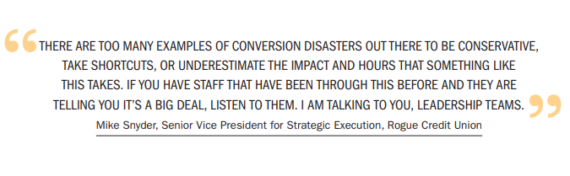
Rogue Credit Union
About the Credit Union
Conversion Quick Facts
Go Live: March 1, 2021
Converted From: Fiserv’s Spectrum
Converted To: to Fiserv’s DNA platform
Headquartered in Medford, OR
Approximately $3.3B in assets
Over 207,000 members
26 branches, 622 FTEs
Notes:
We launched Affinity Gives Back Day on Columbus Day in 2017 and have since extended it to Affinity Gives Back Week to foster goodwill among employees, members, and community.
Employees volunteer with our Foundation’s charity partners, provide financial literacy seminars to nonprofits and local schools, and participate with causes they’re passionate about.
In 2019, 100 employees volunteered at 16 charities. In 2020, we had several individual/small team in-person opportunities (adapted to ensure safety/follow all COVID-19 guidelines) and volunteer from home options including mask making for Jersey Cares.
We know that volunteers are essential to tackling the crisis created by the pandemic to help communities heal physically and economically. We are in the process of surveying our employees to gauge their comfort levels and are scheduling events in areas where employees have expressed interest in volunteering this year.
Some of our partners over the years include America’s Grow-a-Row, Cornerstone Family Programs, the Flemington Area Food Pantry, Homeless Solutions and Lunch Break.
Throughout the year, we encourage our employees to submit their time to earn Volunteer Time Off, wear Affinity branded clothing to their events, set their out of office messaging, share their photos and spread the word on social that they’re giving back with #AffinityCares
This year, we plan to incorporate more virtual opportunities in our program and will keep working with community partners to offer help where it’s needed most year-round.
During our week of service this year, we will celebrate our Foundation and community impact, host our annual volunteer appreciation lunch, and offer financial wellness free for the community.

Slide 6

Q&A Discussion Period

Slide 7
  THANK YOU FOR WATCHING
1001 Connecticut Ave NW
Ste. 1001
Washington, DC 20036
callahan@callahan.com
www.callahan.com
800-446-7453

