Slide 1


HOW TO SERVE FIRST-TIME AUTO BUYERS
American 1 Credit Union

Slide 2
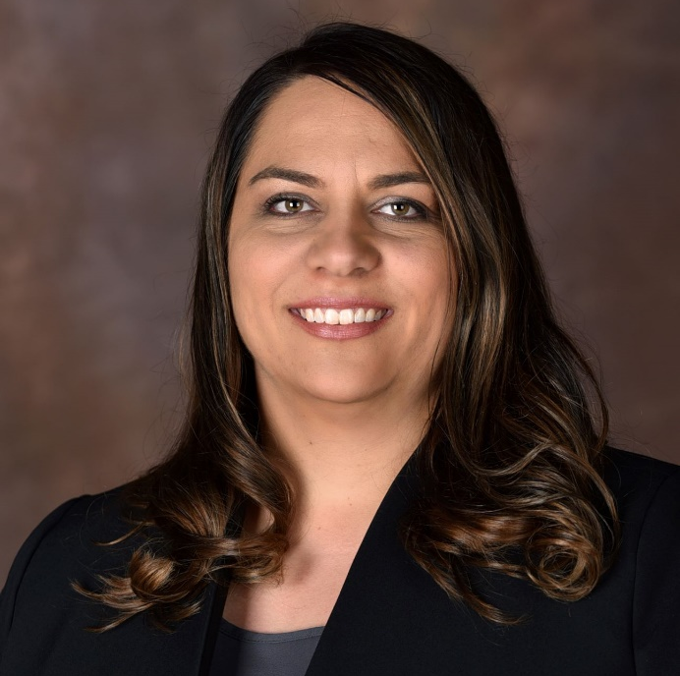
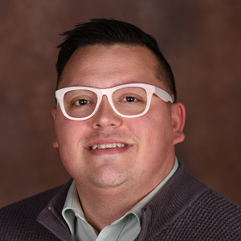
Our Speakers from American 1 Credit Union
Who we are
Carolyn Duncan
Chief Member Experience Officer
Chris Zegarlowicz Lending Manager

Slide 3
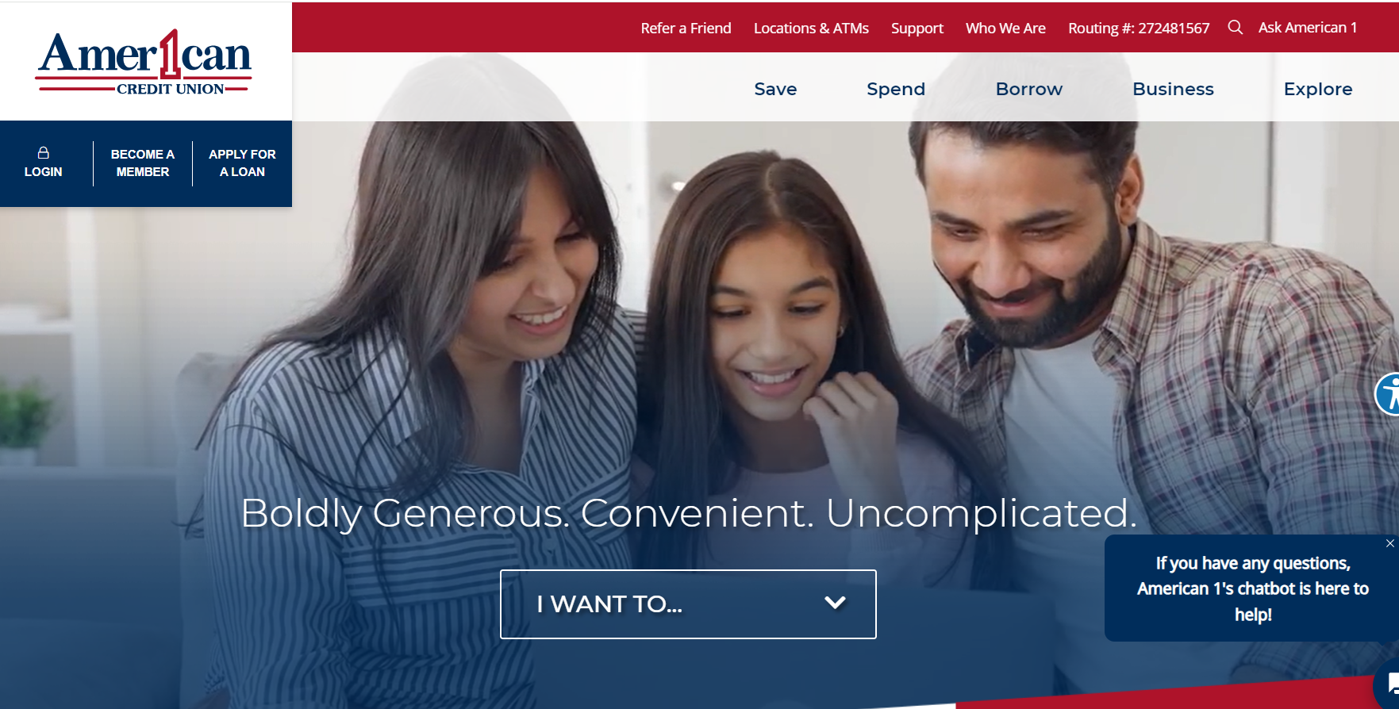
Who we are
About American 1 Credit Union
Jackson, MI
Approx. $684M in assets
Over 64,000 members
259 FTEs
18 branches

Slide 4
Who we are
The Challenge/Opportunity
According to online car guide Edmunds, the cost of financing a new vehicle is at an all-time high.
17.1% of consumers who financed a vehicle in the second quarter of 2023 are making a monthly payment of $1,000 or more.
Average monthly payments also reached a new record of $733 in the second quarter. Used car payments averaged $533.*
Between higher interest rates and higher prices, consumers are feeling the pinch, but they still need reliable transportation.
This is especially difficult for consumers with no credit history.
*Source: Yahoo Finance

Slide 5
A Solution for First-Time Buyers
American 1 saw an opportunity to help facilitate the lending journey of younger members in a responsible way.
We launched our First-Time Auto Buyers program at the end of 2022 after months of research and close collaboration between the marketing and lending teams.
We began with a “soft launch” phase to identify members who qualified and explored the opportunity with them rather than marketing the new program broadly.
That individualized process helped us refine the program before kicking off more traditional marketing and promotion.

Slide 6
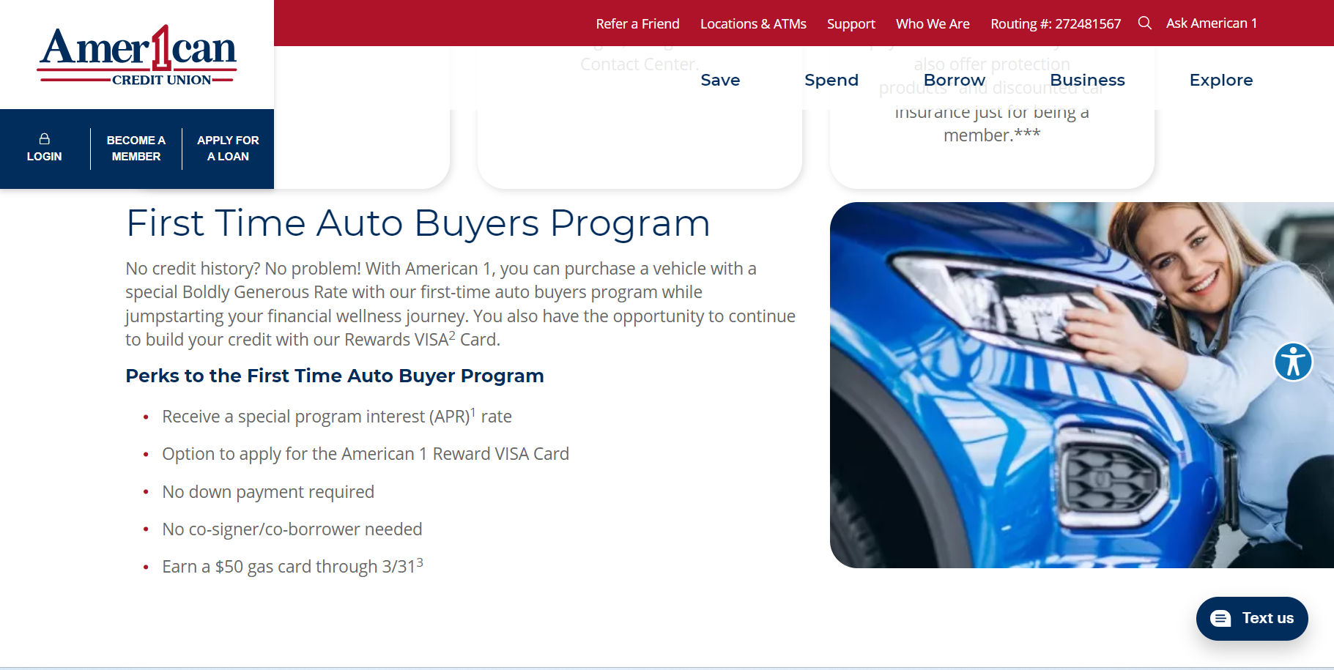

Slide 7
Program Details
The goal of the program is to serve “no score” applicants, or those without a credit history.
In lieu of a traditional credit score, members must meet other criteria, including:
  six months of continuous employment
  income verification
  debt-to-income requirements
  loan-to-value restrictions.
For those who qualify, the maximum loan a borrower can take out is $25,000 compared with other programs which are often capped at $15,000.

Slide 8
Additional Benefits for Borrowers
Holding onto the vehicle and making on-time payments on the loan is one way a new borrower can build credit.
American 1 also issues each borrower a companion credit card and provides pointers on how to build and use credit responsibly.
Meanwhile, the extra buying power helps borrowers avoid old vehicles that can require costly or ongoing repairs.
Additionally, we offer a rate reduction after members make on-time payments for a year.
The starting interest rate on an auto loan through this program is already competitively priced at 9.49%, compared with the 15% to 18% borrowers would pay if they did not qualify.

Slide 9
Uncomplicated Yet Beneficial
We don’t require borrowers to have a credit union checking account.
Additionally, borrowers don’t need a co-signer — a traditional requirement for “no score” applicants — which empowers them to step out on their own.
So far, first-time auto buyers have predominantly fallen into the 18–22-year-old age range. However, these kinds of programs have the potential to impact a much broader demographic. For example, a gentleman in his 50s with no borrowing history and no credit score was able to take advantage of a similar program.
We’re seeing not only those just entering adulthood but also those who haven’t established credit.

Slide 10
Who we are
Results to Date
206 First Time Auto Buyer loans closed
  $2,556,886 in total lending
  Average loan amount of $12,412
  Over 79% have companion Credit Card (164)
    122 with a balance
      Total balance on these cards $203,210
      49% total utilization
        2 are 60+ days delinquent
  Average credit score since loan opening (excluding current no scores) is 647

Slide 11
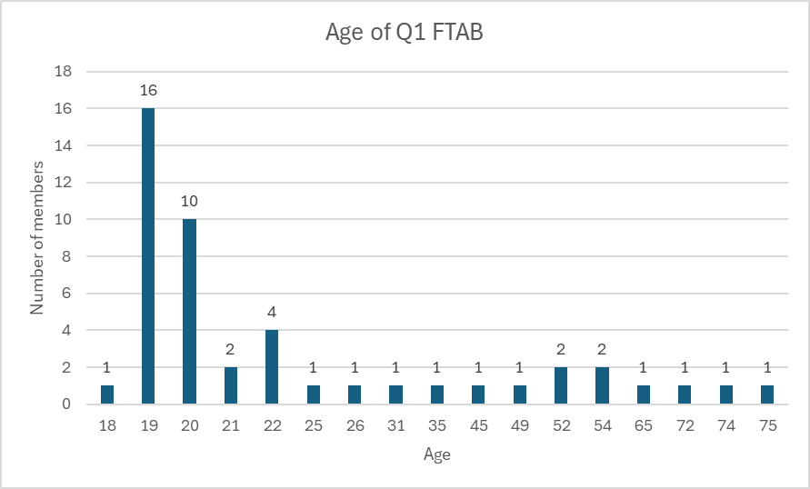
Who we are
Results to Date
47% of First Time Auto Buyer Loans to New Members

Slide 12
Who we are
Results to Date
Reviews
“The service was amazing, and they made sure it was as easy as possible for me. As someone who has never had a loan, or even credit, Adam was super helpful and explained everything to me and made sure I got the best loan I could.”
“The staff, explanations, and overall experience were absolutely amazing. Marcos is a very good employee. I'm 18 and just got my first truck. Marcos answered every question I had very clearly. He explained things so I could understand them without a problem.”
“This place changed my life. I got my own car and a line of credit to build my credit up so I can accomplish things in the future. Everyone was nice and easy to work with. They were quick with their work. I already recommended a few friends to go to American 1. “

Slide 13
Who we are
Lessons & Future Plans
This is another way to serve the underserved as a lack of knowledge can turn buying a car into a predatory experience if the borrower doesn’t have a trusted financial partner.
We dealt with some fraud initially, which our team was pretty quick to identify. It was an early lesson on effectively preparing for, tracking and managing new risks.
Our advice is to carefully plan how to track the program internally to enable timely course corrections.
It’s also important to maintain contact with these borrowers. By continuing to have conversations and review their credit report with them after a year, it opens the door to additional insights and avenues to financial wellness.

Slide 14

Q&A Discussion Period

Slide 15
  THANK YOU FOR WATCHING
1001 Connecticut Ave NW
Ste. 1001
Washington, DC 20036
callahan@callahan.com
www.callahan.com
800-446-7453

