Slide 1

Next Steps to CDFI Recertification:
Assessing How Your
Credit Union Moves Forward
January 17, 2024
Mike Beall, Host

Slide 2
CDFI Recertification – TIMING is KEY
December 20, 2024 is the DEADLINE to submit recertification
Don’t decide without all the facts in hand!
Impacts to FA 2024 Grant Submissions:
Submissions due February 15, 2024
Decisions for grant winners – CDFI says September 2024
Credit Unions SHOULD submit their grants as written
When you started, the award was up to $1million – NOW up to $2 million
Filing your 2023 Annual Certification Report – Due March 30, 2024
Submitting under the previous certification rules, not the new ones
When you file next year (2025) – those will impact whether you could go into CURE

Slide 3
Getting Recertified as a CDFI – Key Dates
CU Strategic Planning is your partner to get recertified. It will happen!
January 22, 2024:
Starting to Send Recertification Proposals.
Want to start working on them ASAP!
FA 2025 Grant writing is open. We encourage CUs to sign before June 30 to guarantee pricing.
Before end of May 2024:
CU board must adopt a community development mission statement by their May 2024 board meeting
CU Strategic Planning can/will write these statements and can/will even present them to your board if you want us to (Jessica La Rocca)

Slide 4
Getting Recertified as a CDFI – 2024 Key Dates
Sep. 2024
FA 2024 Awards Announced
30 June 2024
Deadline for signing to move forward on FA 2025 FA/TA Grant
Oct. 2024 (CU Strategic Planning)
Deadline to move forward
on recertification
20 Dec. 2024
Deadline to submit CDFI Recertification to CDFI Fund

Slide 5

Future Cast of Grants and CDFI Certification
Submitting CDFI Recertification December 20, 2024
      Likely submitting them towards the end of the year
      FA 2024 – Win in September 2024
            Book part in 2024, the rest in 2025
            (Before CDFI Fund acts on recertification)
Recertification Analysis by CDFI Fund – 2025
      Earliest they are likely to review is late summer of 2025
      Using ACR data from 2024 reports – submitted March 30, 2025
            ACR analysis expected to come out in late summer 2025
      Credit unions with identified compliance issues could be issued CURE letters – Fall 2025
CURE (Things to fix) Letters on Recertification
(We work with you)
      Likely date for submission of CURE materials – fall 2026

Slide 6
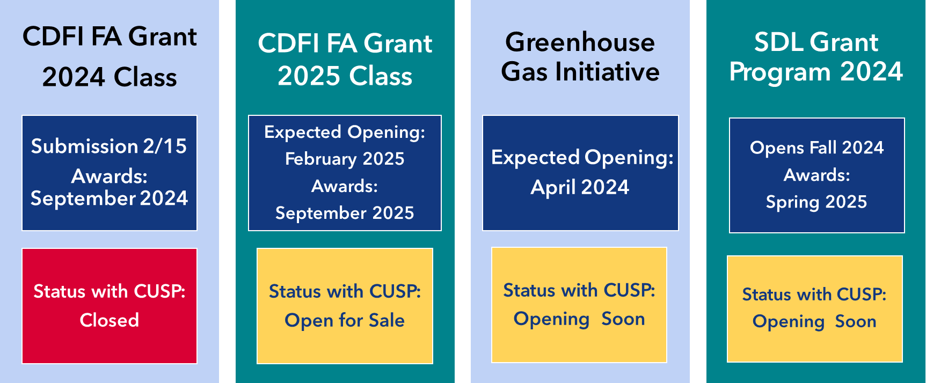
CDFI Grant Programs +

Slide 7
Practices Requiring Explanation on Community Development Promotion
CDFI Fund: While these practices could be implemented in an abusive manner, they COULD BE used to promote community development.
Practices:
    Failing to evaluate ability to repay
    Small business loans with 36%+ APR
    Single family, owner-occupied residential mortgages with balloon payments or 30+ years maturity.
    Overdraft fees that exceed amount of item cleared
    Charging more than 6 ODP fees in a 12-month rolling period
    NSF fees that exceed amount of item returned

Slide 8
Can ODP be Justified?
Yes, BUT….
  ODP must be used in a way that is consistent with a community development mission
  SOLUTION
CDFI Fund requires an explanation to clarify how the program promotes community development
Programs should:
    Not harm consumers
    Be affordable and not excessive in costs
    Have transparent terms and conditions understandable to user

Slide 9
Potential Impacts of ODP Elimination
ChexSystems Implications:
      Can’t open a savings or checking account
      Can impact ability to obtain housing
      Can impact ability to obtain employment
      Forces consumers INTO payday lender’s products
Bounced checks a felony in many states
Forcing low-income individuals to turn to payday lenders

Slide 10






Competitors who are proudly proclaiming their zero or low-cost overdraft and NSF fees.
But these same competitors are charging fees in other areas
(higher maintenance fees, transfer fees) to make up the difference.

Slide 11
The view from NCUA Chairman Todd Harper
“Heavy reliance on overdraft programs can harm members…but a complete discontinuance of overdraft programs is not necessarily the best fit for all credit unions.”
“Review how these programs are used and whether they benefit members or allow them to make the best of use of their checking accounts.”
NCUA Chairman Todd Harper, March 23, 2022

Slide 12
Protecting Members and your Bottom Line
Understand which members frequently overdraft; when they are likely to do so and why it is happening
Possible member-friendly reforms to ODP:
      Use loan products as a backstop to NSF; small dollar loans, lines of credit
      Provide tools to help member with overdraft-like financial counseling and workout loans
      Reduce or eliminate fees on small transactions
  Offer premium checking accounts with subscription fees in lieu of courtesy pay
Source: “Overdraft Protection Programs: CU Best Practices,” Filene Institute

Slide 13
Public Meeting of the CDFI Fund's Advisory Board January 17, 2024
Starts at the end of our meeting – 3pm Eastern
Webinar Access: https://www.mymeetings.com/nc/join/
Conference Number: PWXW3330965
Audience Passcode: 2475113
Toll Free Number: (888) 323-9929

Slide 14
Thank You!
For more information on how we can help you retain your CDFI certification, contact:
christopherv@custrategicplanning.com
calendly.com/christopherv-1/next-steps-to-cdfi-recertification

